Slide 1
Global Azure Bootcamp 2017 Linz, Austria
Jürgen Mayrbäurl, Solution Architect for IoT, PDS Tech Sales

Slide 2
What is a container?
Windows Server Container Maximum speed and density
Container
Container
Container
Docker containers
= shared operating system
OS
Kernel
Container
Container
Container
Applications
Kernel
Hyper-V Isolation Isolation plus performance
Hardware
Container
Container
Container
Kernel
Kernel
Kernel
Hyper-V

Slide 3
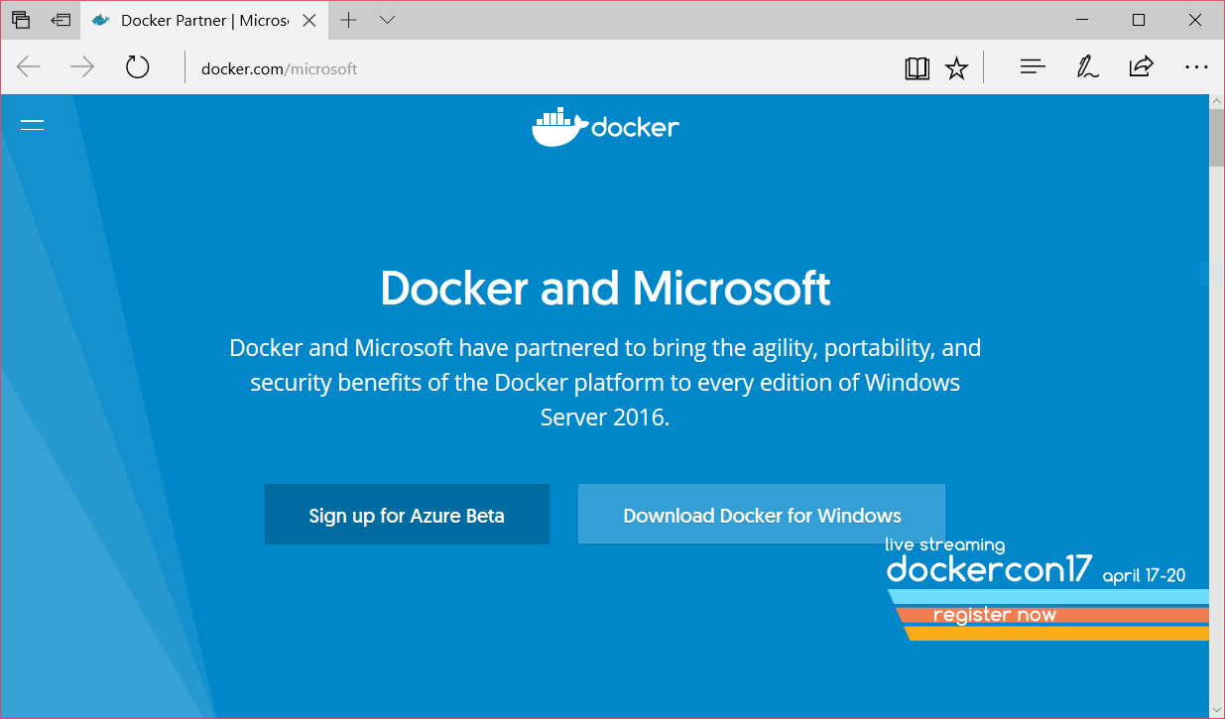

Slide 4
Top drivers for customer application modernization
3out 4
Top initiatives revolve around application modernization—traditional and microservices¹
44%
Looking to adopt DevOps
APP MODERNIZATION
DEVOPS
$15
Million
The average cost/business impact per security breach is $15 million²
80%
Containers and Docker is central to on-premises and hybrid cloud strategy
CLOUD
SECURITY
1. State of App development Survey: Q1 2016 Morgan Stanley CIO Survey: June 30, 2016
2. Source: Ponemon Institute, “2015 Cost of Cyber Crime - US”

Slide 5






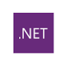






Docker & Microsoft address 98% of Enterprise App Requirements
FROM DEV
< >
TO OPS
ANY OS
LINUX
WINDOWS
ANYWHERE
PHYSICAL
VIRTUAL
AZURE CLOUD
ANY APP
TRADITIONAL
MICRO SERVICES
MORE
ANY LANGUAGE

Slide 6
Customer benefits: speed, flexibility, and savings
AVAILABILITY
PORTABILITY
AGILITY
62%
Report reduction in MTTR
41%
Move workloads across private/public clouds
13X
More software releases
10X
Cost reduction in maintaining existing applications
65%
Reduction in developer onboarding time
Eliminate
“Works on my machine” issues
Secure Software Supply Chain
State of App development Survey: Q1 2016, Cornell University case study.

Slide 7
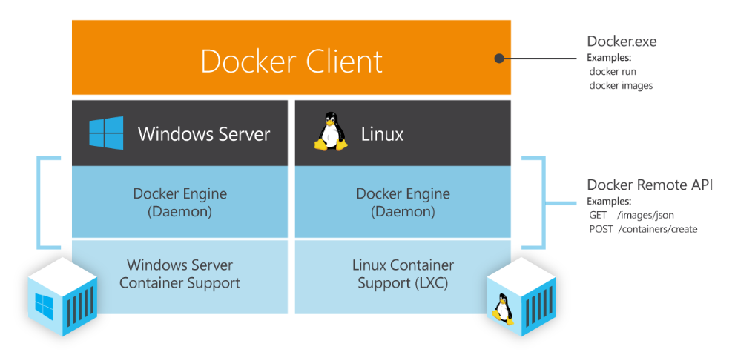
Docker Engine für Windows

Slide 8
Docker on Windows PC

Slide 9

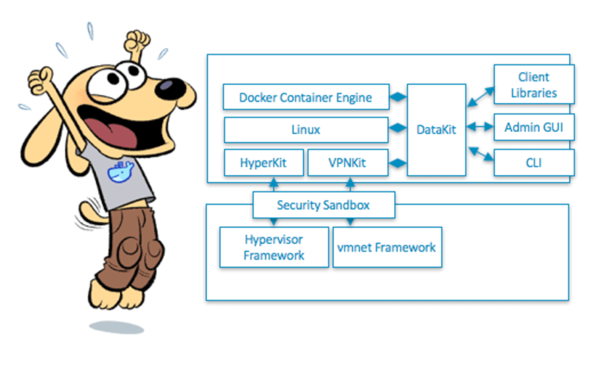
Docker for Windows PC
An integrated, easy-to-deploy development environment for building, debugging and testing Docker apps on a Windows PC. Docker for Windows is a native Windows app deeply integrated with Hyper-V virtualization, networking and file system, making it the fastest and most reliable Docker environment for Windows.
Kostenloser Download unter:
https://store.docker.com/editions/community/docker-ce-desktop-windows

Slide 10
Demo
Docker on Windows Client PC

Slide 11
Demo script – Docker on Windows PC
Open Cmd Prompt Window and show ‚docker info‘
Run Tomcat with ‚docker run -d -p 8080:8080 tomcat’
Show Docker symbol in Task bar
Show Docker settings
Show Kitematic app – running Crate DB
Show Docker Linux VM in Hyper-V Manager

Slide 12
Docker on Azure VMs

Slide 13

Option 1 for running a Linux Docker image
ARM Template with
Docker VM Extension
Azure Fabric
network
services
VM
agent
Docker Extension
< code >
Other Extensions
< code >

Slide 14
Demo
Deploy Docker on Ubuntu Linux Azure VM with CLI and ARM template

Slide 15
Demo script – Docker on Azure with VM Ext.
Based on https://docs.microsoft.com/en-us/azure/virtual-machines/virtual-machines-linux-dockerextension
Start Azure Command Prompt
Use Azure Resource Manager: azure config mode arm
Login to Azure: azure login
Switch to subscription: azure account list, azure account set "Microsoft Demos and PoC“, azure account show
Create VM with template: azure group create --name GAB2017VM --location "North Europe“
Create VM with template: azure group deployment create --resource-group GAB2017VM --template-uri https://raw.githubusercontent.com/Azure/azure-quickstart-templates/master/docker-simple-on-ubuntu/azuredeploy.json
Wait for deployment: azure vm show -g GAB2017VM -n MyDockerVM
Login via SSH jmgab2017vm.northeurope.cloudapp.azure.com azureuser/Password
Start nginx on Docker: sudo docker run -d -p 80:80 nginx

Slide 16





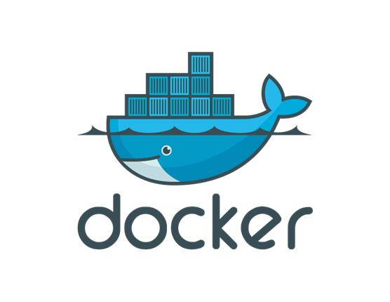



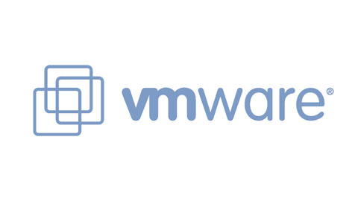
Option 2 for running a Linux Docker image
Docker Machine
It’s a tool that make really easy to create Docker hosts on your computer, on cloud providers and inside your own data center.
It creates servers, installs Docker on them, then configures the Docker client to talk to them.

Slide 17
Demo
Docker on Azure with Docker Machine

Slide 18
Demo script – Docker on Azure with Machine
Based on https://docs.microsoft.com/en-us/azure/virtual-machines/linux/docker-machine
Open Cmd Prompt Window
Create VM with docker-machine create -d azure --azure-ssh-user ops --azure-subscription-id a7cfa132-0b09-48a9-898e-06fc662a1718 --azure-open-port 80 machine
Check Env settings: docker-machine env machine
Export Env settings from previous command
Run Container on remote host: docker run -d -p 80:80 --restart=always nginx
Check it's running: docker ps
Open web browser

Slide 19

Option 3 for running a Linux Docker image
Docker Compose
A tool for defining and running complex applications with Docker.
Using Compose is a three-step process.
1
compose
You define your app’s environment in a Dockerfile.
2
You define the services that make up your app in docker-compose.yml
web:
build: .
links:
- db
ports:
- "8000:8000"
db:
image: postgres
You run docker-compose up and it will start and run your entire app.
3
Compose is great for development environments, staging servers, and CI. It’s not recommend that you use it in production yet.

Slide 20
No Demo
See https://docs.microsoft.com/en-us/azure/virtual-machines/linux/docker-compose-quickstart

Slide 21
Windows Containers

Slide 22
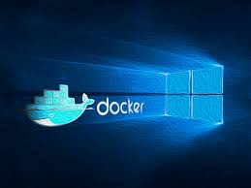
Windows Container
On Windows Clients
Natively on Windows Server 2016
With Azure Container Services

Slide 23
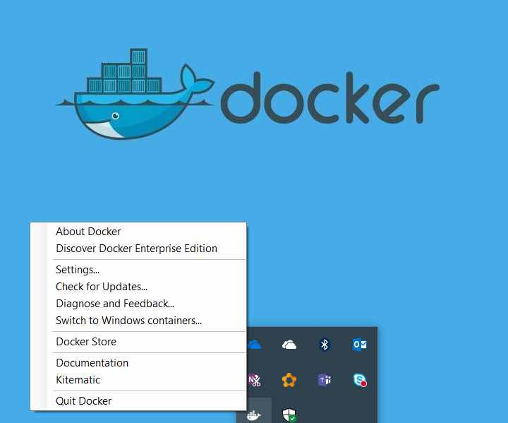
Windows Container on Client PC
Select in context menu in task bar

Slide 24
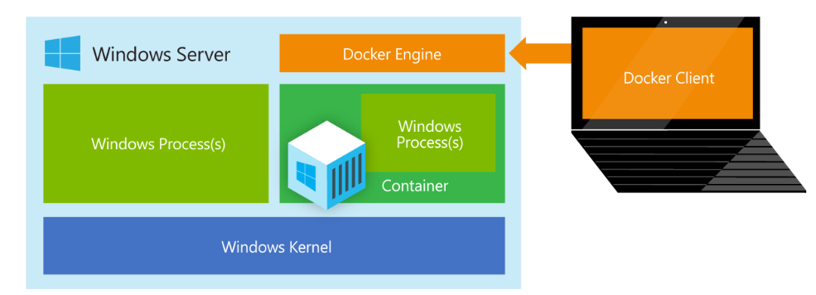
Windows Container on Windows Server 2016
Installation instructions at: https://blog.docker.com/2016/09/build-your-first-docker-windows-server-container/

Slide 25
Demo
Docker with Windows Server 2016 on Azure

Slide 26
Demo script – Docker on Windows Server 2016
Based on https://blog.docker.com/2016/09/build-your-first-docker-windows-server-container/
Open Azure Portal
Create new VM based on ‚Windows Server 2016 Datacenter - with Containers’
Use Remote Desktop
Open local PowerShell Prompt
Show docker info: docker info
Show basic installed images: docker images –a
Create an image on the fly: "FROM microsoft/windowsservercore `n CMD echo Hello World!" | docker build -t jmayrbaeurl/windows-test-image –
Run the container: docker run jmayrbaeurl/windows-test-image

Slide 27
Windows base images and ecosystem
microsoft/windowsservercore | microsoft/nanoserver
basically Windows Server dotNet framework 9.3 Gigs large fully compatible supports existing Windows Apps | very smaller ~600MB no graphic stack, Faster and less memory smaller API surface existing application mightn't be compatible
For more details see https://blogs.technet.microsoft.com/windowsserver/2016/06/21/the-windows-server-2016-application-platform-nano-server-containers-and-devops/

Slide 28
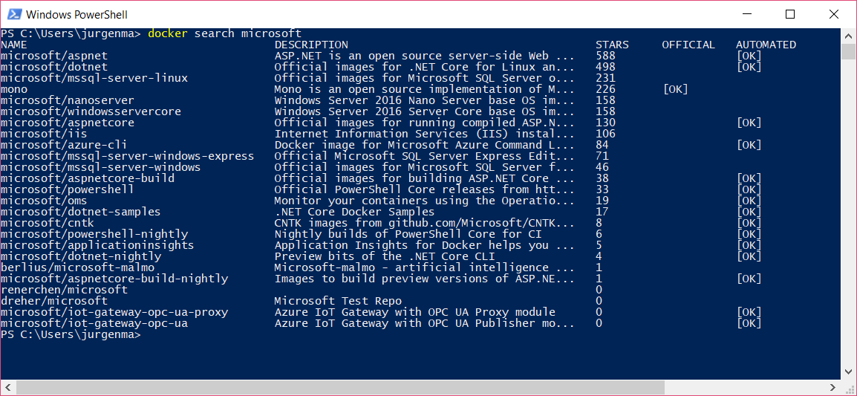
Available images on Docker Hub registry

Slide 29
Azure Services for Docker

Slide 30
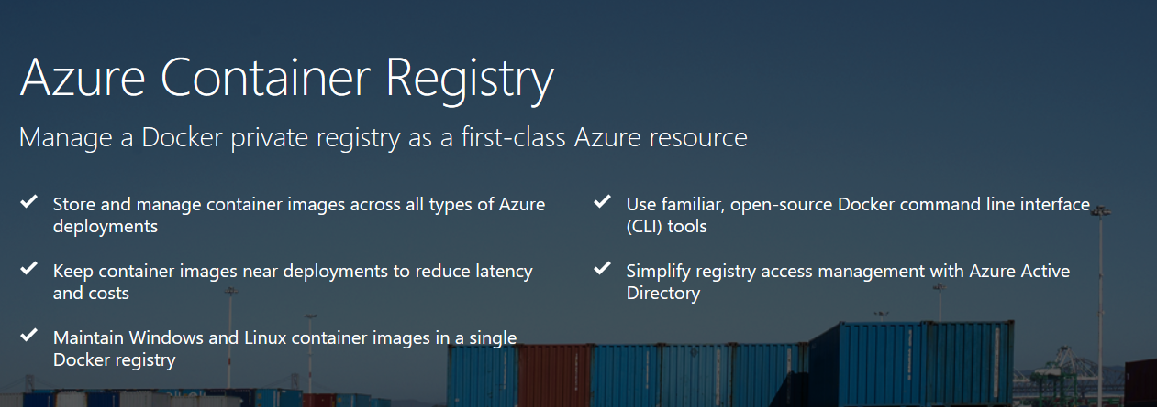
Azure Services for Containers – Container Registry

Slide 31



Azure Services for Containers – Container Service
Azure Container Service
Standard tooling and API support
Streamlined provisioning of DC/OS, Docker Swarm, and Kubernetes (in preview)
Kubernetes
DC/OS
Swarm

Slide 32
Demo
Docker with Azure Container Service

Slide 33
Demo script – Docker with Azure Container Service
Based on https://docs.microsoft.com/en-us/azure/container-service/container-service-deployment
Open Azure Portal and create new ACS instance
Set up SSH tunnel with Putty
Connect to Swarm cluster with set DOCKER_HOST=tcp://127.0.0.1:22375
Run simple Webserver: docker run --name hello-nginx -d -p 80:80 nginx
Check it‘s running: docker ps –a
Use Agent LB IP http://52.169.64.177/ in web browser

Slide 34
Tools and the future

Slide 35
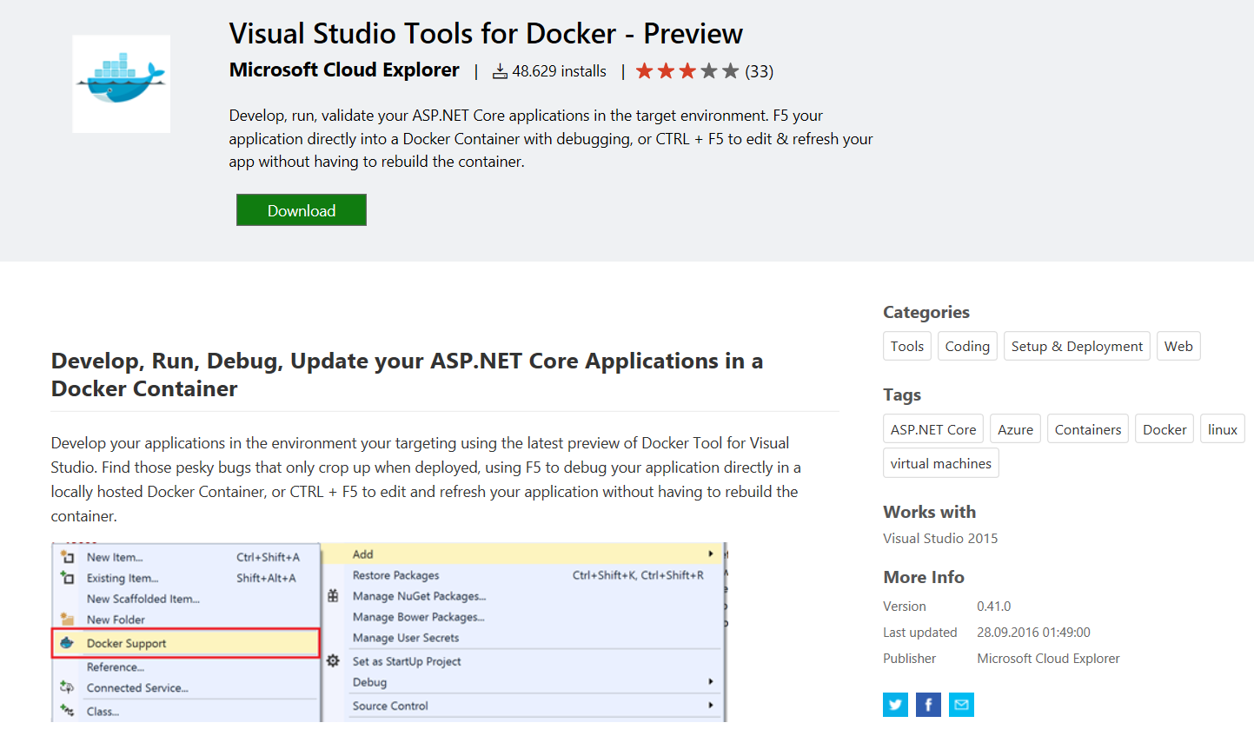
Tools support – Visual Studio

Slide 36
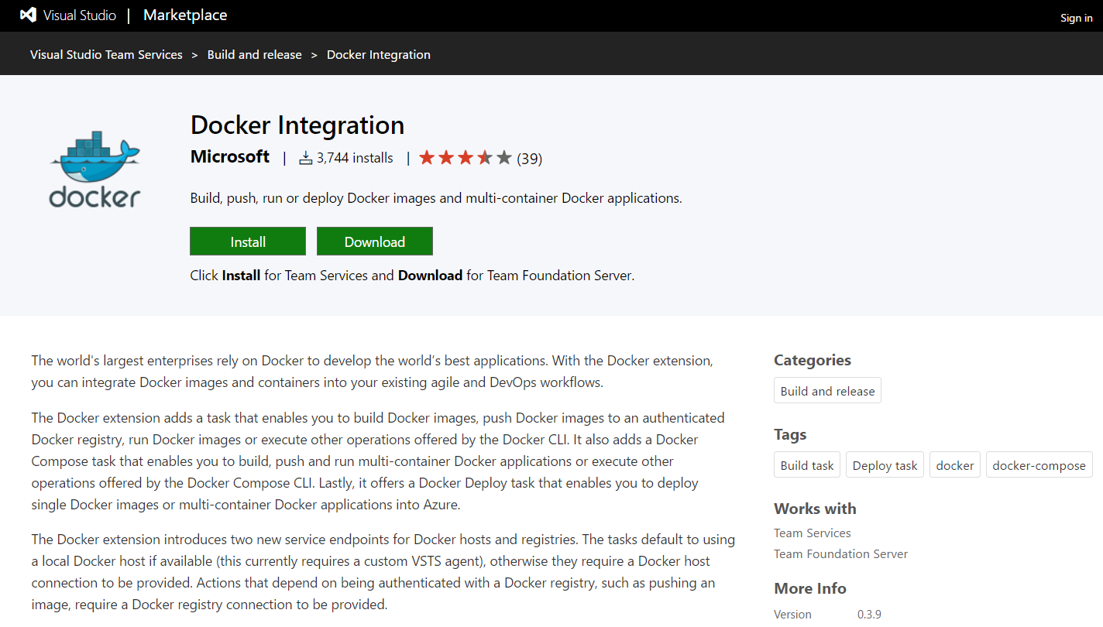
Tools support – Visual Studio Team Services

Slide 37
The future
Image2Docker: Available in PowerShell Gallery
Windows Container deployment to Service Fabric: blog post
App Service on Linux with containers: Currently in preview, see blog post
Other Azure services, e.g. HDInsight, ...
News from DockerCon 2017: Networking support for Docker Swarm Mode, Linux Container options for Windows Server (Day 1 and Day 2 announcements)

Slide 38

Next steps
MICROSOFT & CONTAINERS
http://Microsoft.com/containers
DOCKER & MICROSOFT
http://docker.com/microsoft
CONTAINERS DOCUMENTATION http://aka.ms/containers
CONTAINERS INFOGRAPHIC https://info.microsoft.com/rs/157-GQE-382/images/Container%20infographic%201.4.17.pdf
IMAGE2DOCKER TOOL
Blog: https://blog.docker.com/2016/09/image2docker-prototyping-windows-vm-conversions/
Tool: https://github.com/docker/communitytools-image2docker-win

